Slide 1

Looking to the Future
MIS 689
Cyber Warfare
Capstone

Slide 2
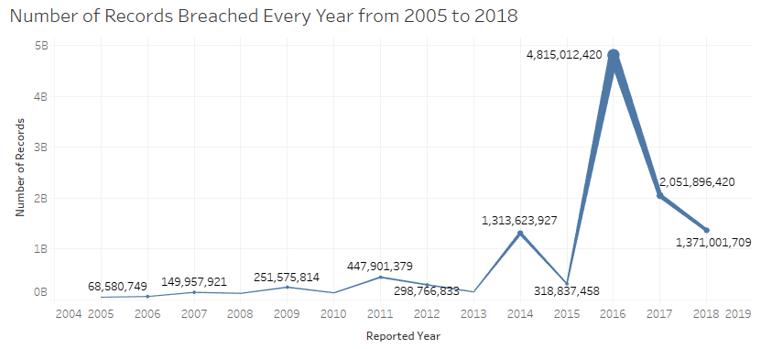
Some Facts
Data breaches since 2005 reported by Federal Trade Commission (FTC) (Clearinghouse, 2019).
# of records Breached: 11.5B+; # of data breaches: 9K+
Major Data Breaches
Yahoo! : 3.5B user accounts
FriendFinder : 412M user accounts
MySpace : 360M passwords
Figure 1. Number of Records Breached

Slide 3
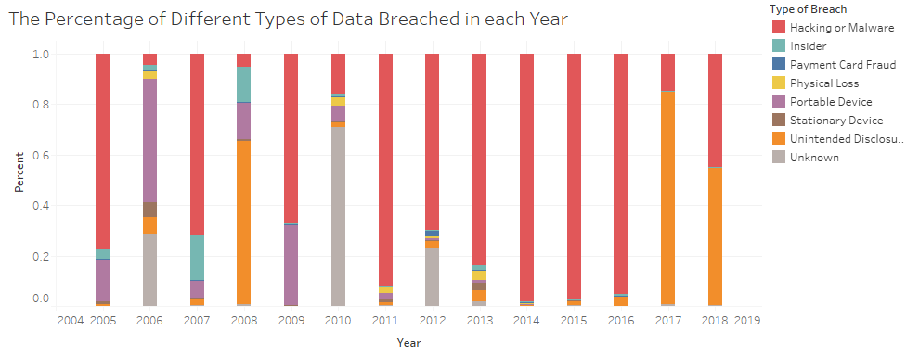
Data Breach Types by Causes
Figure 2. The Percentage of Different Types of Data Breached in each Year
Key Observation:
Hacking or Malware is the main cause of data breach in recent years.
Dark Web is a valuable source of cyber intelligence (Du et al., 2018)
Notes:
Payment Card Fraud (CARD): Fraud involving debit and credit cards that is not accomplished via hacking. For example, skimming devices at point-of-service terminals.
Hacking or Malware (HACK): Hacked by outside party or infected by malware
Insider (INSD): Insider (someone with legitimate access intentionally breaches information – such as an employee, contractor or customer)
Physical Loss (PHYS): Includes paper documents that are lost, discarded or stolen (non electronic)
Portable Device (PORT): Lost, discarded or stolen laptop, PDA, smartphone, memory stick, CDs, hard drive, data tape, etc.
Stationary Device (STAT): Stationary computer loss (lost, inappropriately accessed, discarded or stolen computer or server not designed for mobility)
Unintended Disclosure (DISC): Unintended disclosure (not involving hacking, intentional breach or physical loss – for example: sensitive information posted publicly, mishandled or sent to the wrong party via publishing online, sending in an email, sending in a mailing or sending via fax)
Unknown (UNKN)

Slide 4
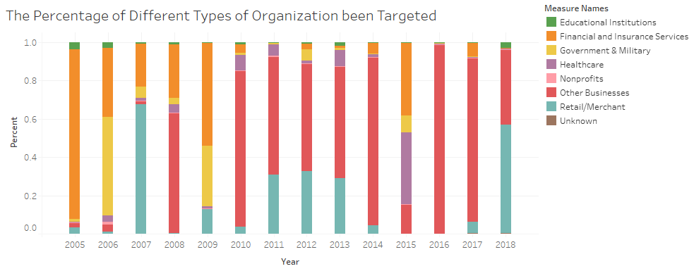
Targeted Organizations
Figure 3. The Percentage of Different Types of Organization Targeted
Key Observation:
Since 2010, Internet/IT (e.g., Yahoo; as Other Businesses) and major Retail/Merchant (e.g., Target) firms are the major targets.
Notes:
BSF: Businesses - Financial and Insurance Services
BSO: Businesses - Other
BSR: Businesses - Retail/Merchant - Including Online Retail
EDU: Educational Institutions
GOV: Government & Military
MED: Healthcare, Medical Providers & Medical Insurance Services
NGO: Nonprofits

Slide 5
Looking to the Future (for Cybersecurity)
Cybersecurity ➔ Continued and escalated concerns for governments, industry, and individuals
Increasingly complex geopolitical landscape ➔ Russian, Chinese, Iranian
IoTs for homes (e.g., smart homes) and industry (e.g., autonomous vehicles, SCADA) ➔ increasing mobile vulnerabilities
Big data ➔ “big data breaches”
AI & Cybersecurity ➔ for better or for worse
Needing a social-technical solution ➔ from engineering to analytics; from protective to proactive; a governments-industry-individual partnership

Slide 6
Congratulations on completing your Cyber Warfare Capstone course and MS in Cybersecurity degree! Best with your career as a Cyber Warrior for the good of the world!

